Slide 1

GameFlow Traffic Control (GTC) A Game Theory Approach To Traffic Signal Optimization
Group Members
Syed Subhan Shah Bukhari (22P-9447)
Maaz Mustafa (22P-9405)
Moiz Ghazanfar(22P-9425)
Project Supervisor
Mr. Usama Musharaf

Slide 2
Table of content
Problem Statement
Literature Review
Diagrams
SUMO & TraCi
Demo and Results Version 01
Demo and Results Version 02
Application Prototype
References
1

Slide 3

Problem Statement
“Conventional traffic signals use fixed-time cycles, which are inefficient as they cannot adapt to real-time traffic fluctuations, leading to unnecessary congestion and long delays.”
2

Slide 4
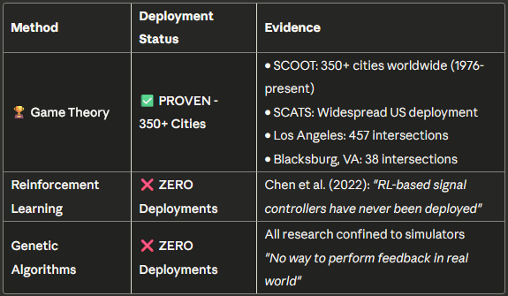
Literature Review: Performance Evaluation
3

Slide 5
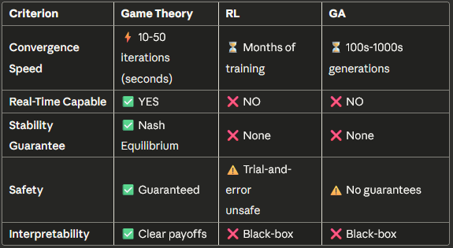
Literature Review: Performance Comparison
4

Slide 6
The ‘Black Box’ Problem
Reinforcement Learning:
“Complex and opaque neural networks hard to understand and debug" (Chen et al., 2022)
Cannot explain why a decision was made
Safety-critical systems require transparency
Genetic Algorithms:
"Survival of the fittest" is not an engineering explanation
No clear decision logic
Difficult to validate and tune
Game Theory:
Clear payoff functions: U = -(α·Wait + β·Delay + γ·Queue)
Engineers understand WHY decisions are made
Easy to validate and adjust
5

Slide 7
Timeline & Our Contribution
1970s ━━━━━ SCOOT/SCATS Development (Game Theory-based)
1976 ━━━━━ First SCOOT Deployment (Glasgow)
1980s ━━━━━ SCATS Deployment (Australia → US)
2000s ━━━━━ GA Research Begins (simulation only)
2010s ━━━━━ RL Research Surge (simulation only)
2019 ━━━━━ Zaied et al.: 457 intersections (Game Theory)
2022 ━━━━━ Chen et al. Review: "RL never deployed"
2023 ━━━━━ Wang et al.: Queue Equilibrium (Game Theory)
2025 ━━━━━ Our FYP: Game Theory in Pakistan
Our Adaptation:
Modified for multiple timeslots
Calibrated for mixed traffic
2-phase system (NS + EW)
Nash Equilibrium optimization
SUMO simulation validation
6

Slide 8
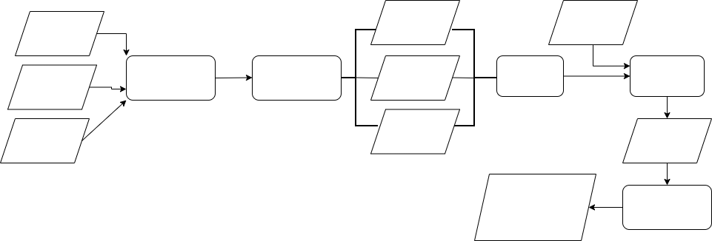
Updated Workflow Diagram
waiting
time
define
players
Traffic
Run SUMO
Generate input data
queue
length
calculate payoff
compute nash
Detectors
unserved vehicles
Intersection
generate signals
Optimize
traffic and wait for next input
feed signals back to SUMO
8

Slide 9
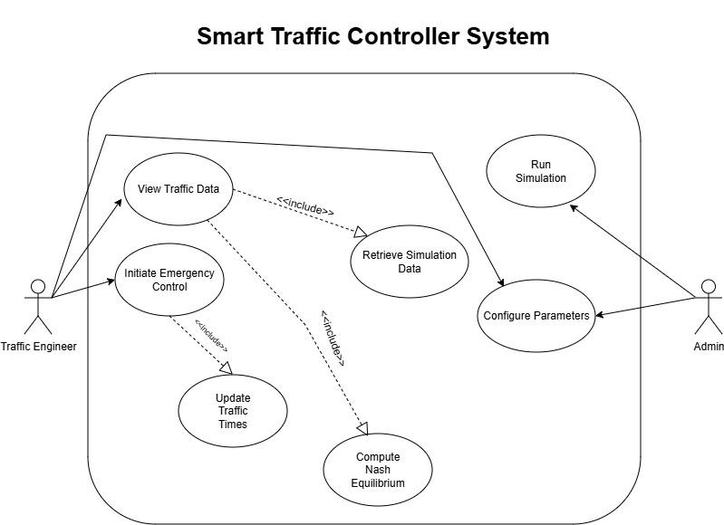
Updated Use-Case Diagram
7

Slide 10
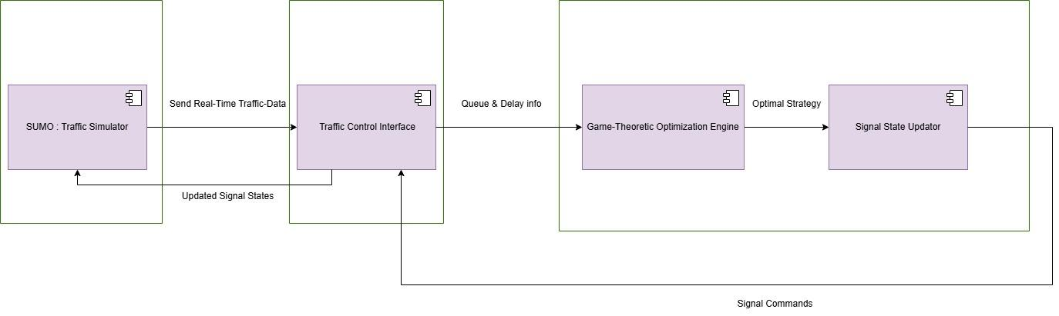
Architecture Diagram
9

Slide 11
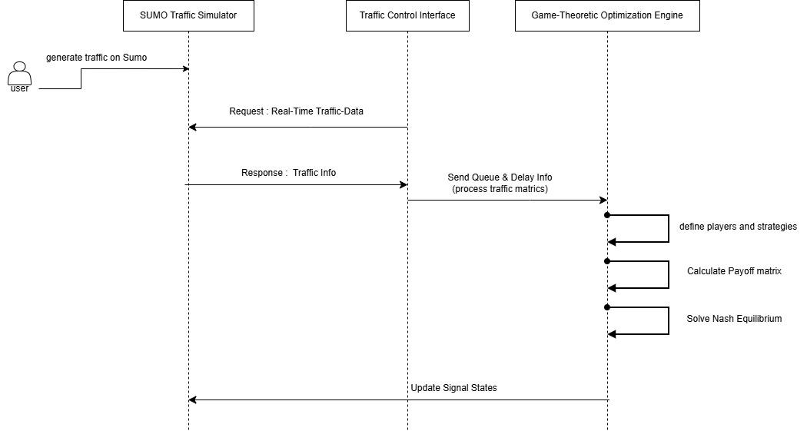
Activity Diagram
10

Slide 12
SUMO and TraCI
Dynamic Network Generation
High-Fidelity Mixed-Traffic Physics
TraCI-Based Stochastic "Chaos”
Dynamic Temporal Phases & Analytics
11
Notes:
Solved the complex issue of vehicle overlapping ("ghosting") by implementing a Sublane Model with high-precision lateral resolution (0.2m). This forces heavy vehicles to maintain strict lane discipline while allowing bikes and rickshaws to realistically weave and filter through gaps.
Utilized the TraCI interface to inject unpredictable, human-like behaviors into the agents. This includes custom algorithms for "Chaos Events" (rickshaws randomly stopping to drop passengers) and aggressive lane-changing, accurately modeling the disorder of South Asian traffic.
The simulation evolves through distinct time-of-day phases (Morning Rush, Mid-day Lull, Evening Rush) to test the network under varying loads. Real-time performance metrics (Queue Length, Wait Time, Chaos counts) are logged per direction ("Player") to CSV for data analysis.

Slide 13
Fixed Timed Signals
(Base Model)
12

Slide 14
Version 1
Constant Variables:
Type of Traffic: Mix and Aggressive
Time Slots = {Early Morning, Afternoon, Evening}
Number of Vehicles per each direction = 10200
Strategy Set = {Red, Yellow, Green}
Number of players = 2
Changing Variables for Version 01:
Sliplanes
Payoff = (α)QueueLength
13

Slide 15
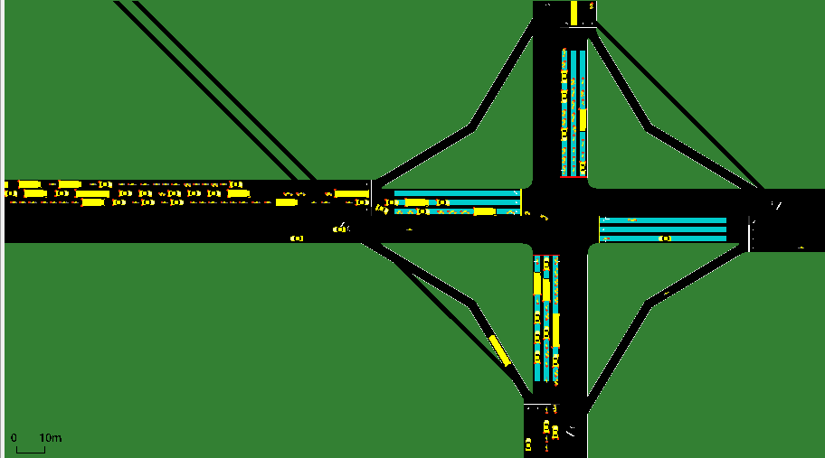
Fixed Timed Model
Total Catastrophe
14

Slide 16
Fixed Timed Model
North & South
Speed: 0.03
Travel Time: 1132.37 seconds.
Teleporting: 36
West & East
Speed: 0.40 to 0.47
Travel Time: ~65–75 seconds.
Spillback along with Unfairness!
15

Slide 17
Game Theory Solution
(With Slip Streams)
16

Slide 18
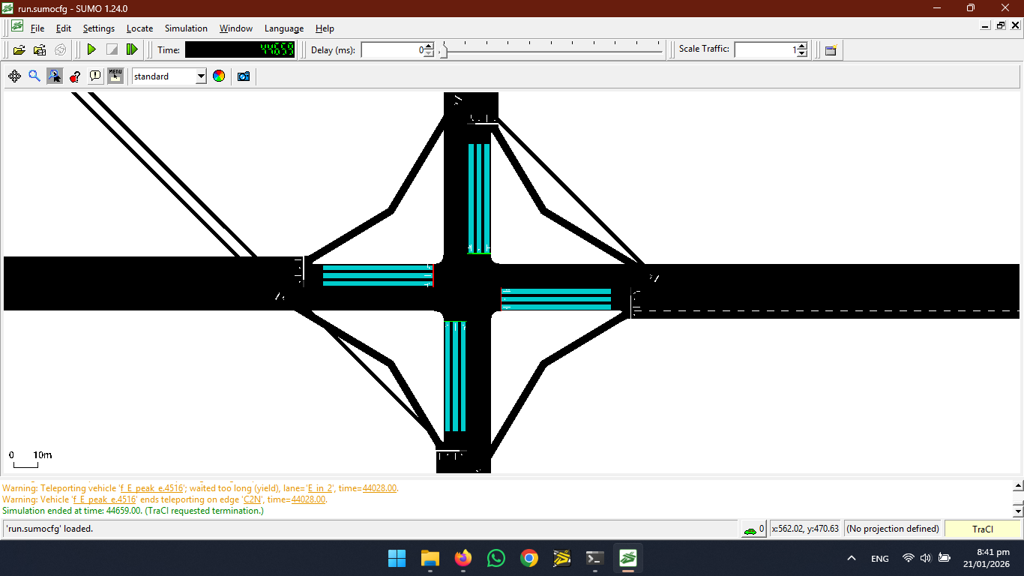
Game Theory Model
Empty Junction
17

Slide 19
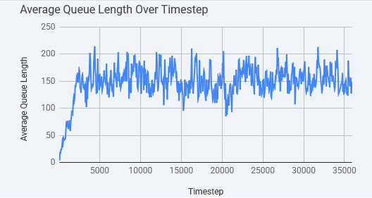
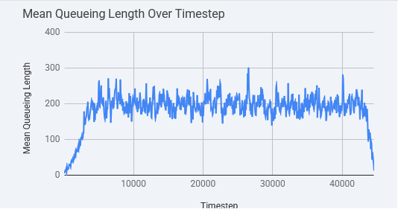
Fixed Timed
Game Theory Model
18

Slide 20
Analysis of GT Solution and Comparison
Average Waiting Time = ~ 500 sec
Average Queue Time = 37 sec
Game Theory was the Solution but had more average waiting time(base model has ~360), WHY?
“Survivor Bias”
19

Slide 21
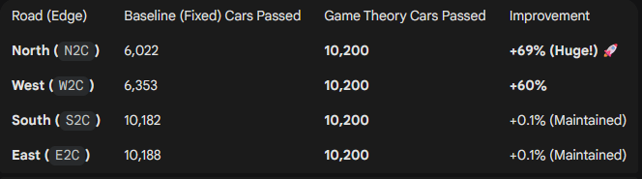
Survivor Bias
20

Slide 22
But its NOT ENOUGH!
21

Slide 23
Version 2
Constant Variables:
Type of Traffic: Mix and Aggressive
Time Slots = {Early Morning, Afternoon, Evening}
Number of Vehicles per each direction = 10200
Strategy Set = {Red, Yellow, Green}
Number of player = 2
Changing Variables for Version 01:
No Sliplanes
Payoff = (α)QueueLength + (β)WaitingTime + (γ)ResidualVehicles
22

Slide 24
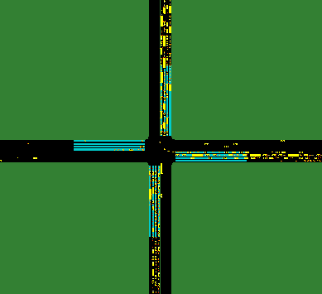
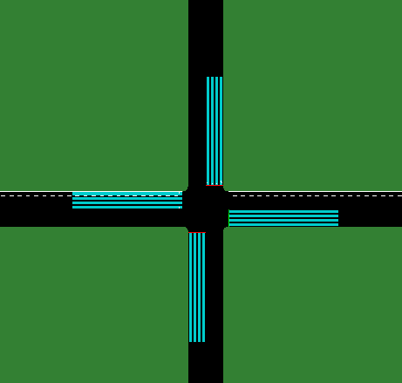
GT vs Base model Using
Real Payoff
23

Slide 25
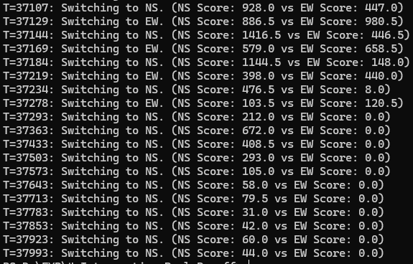
Gametheory at Work!
24

Slide 26


GT vs Base model Using
Real Payoff
25

Slide 27


GT vs Base model Using
Real Payoff
Throughput
26

Slide 28
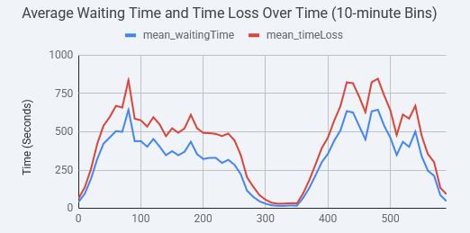
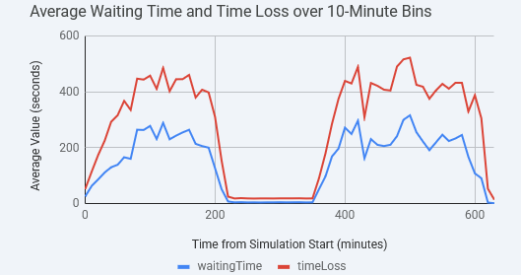
Avg Wait Time
27

Slide 29
Game Theory beat Fixed Timed Signals by half!!!
28

Slide 30
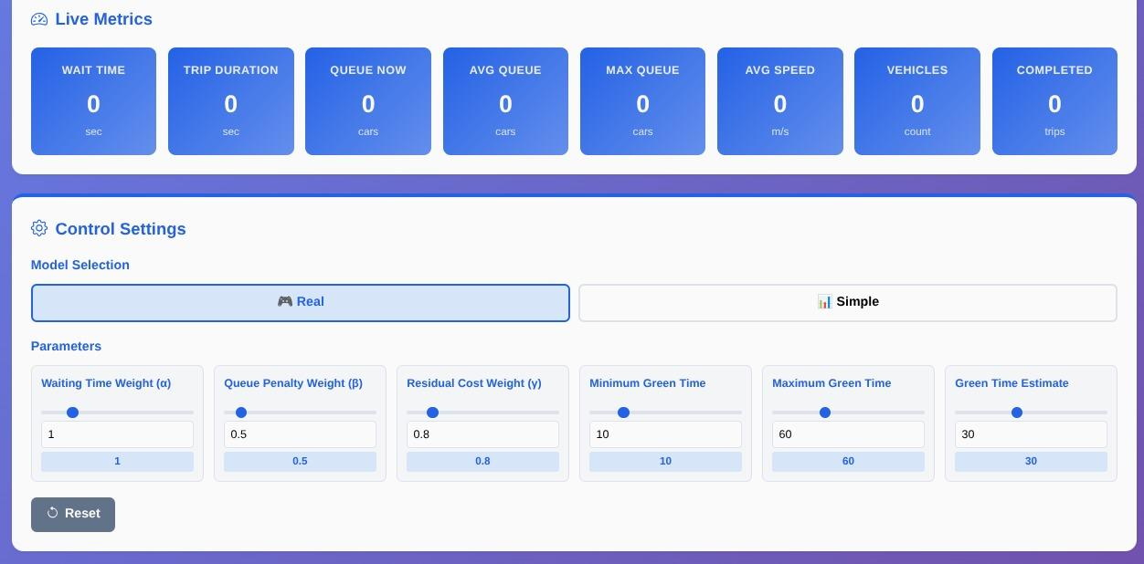
Project App Prototype
29

Slide 31
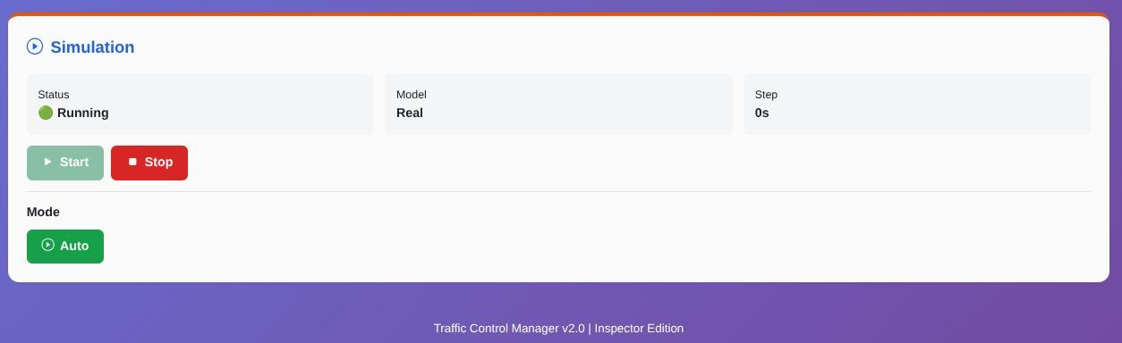
Project App Prototype
30

Slide 32
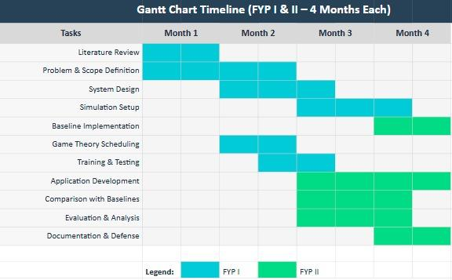
Project Planning
Fig: Gantt Chart
31

Slide 33
References
Game Theory:
Zaied et al. (2019) - Sensors - 457 intersections, Los Angeles
Wang et al. (2023) - Applied Sciences - Queue equilibrium control
Stevanovic et al. (2009) - SCOOT/SCATS deployment review
TRL Software (2024) - SCOOT: 350+ cities worldwide
Reinforcement Learning:
Chen et al. (2022) - arXiv - Comprehensive review
Key Finding: "RL-based signal controllers have never been deployed"
Identifies 4 insurmountable deployment barriers
Genetic Algorithms:
Brazilian NSGA2 Study - "No way to perform feedback in real world"
Multiple IEEE/ACM papers (2000-2020) - All simulation-based
32

Slide 34
Thank You!
33

